Slide 1

EYFS New Parent Meeting
Wednesday, 8th July 2026

Slide 2
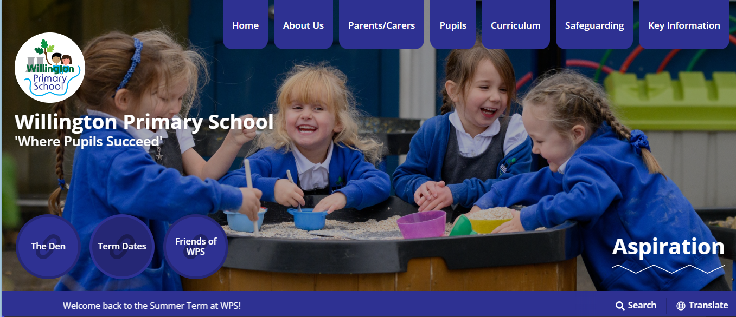

Welcome!
This meeting and presentation aims to share information with new parents which we hope you will find useful in helping your child settle into school and make the most of their first year with us.
This information will also be uploaded onto the school website.
www.willington.derbyshire.sch.uk
To find information relating to our EYFS class look under the ‘Pupils’ tab at the top of the home page and then select…
2026 New EYFS Reception Class

Slide 3

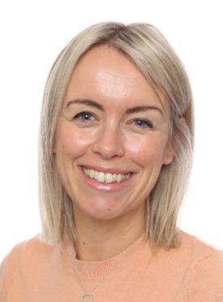
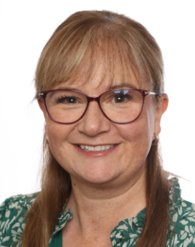
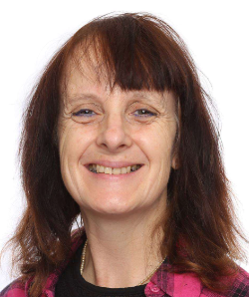
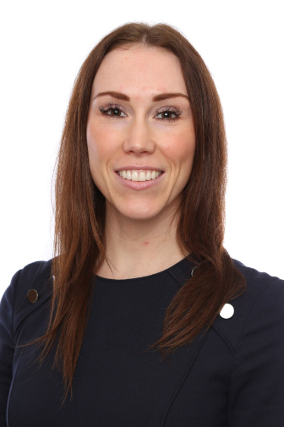
Key Staff for Children in Reception
Mrs Spencer-Lovesey
Headteacher
Mrs Brown
Deputy Headteacher
Mrs Miller
EYFS Class Teacher
Mrs Power
EYFS Teaching Assistant

Slide 4

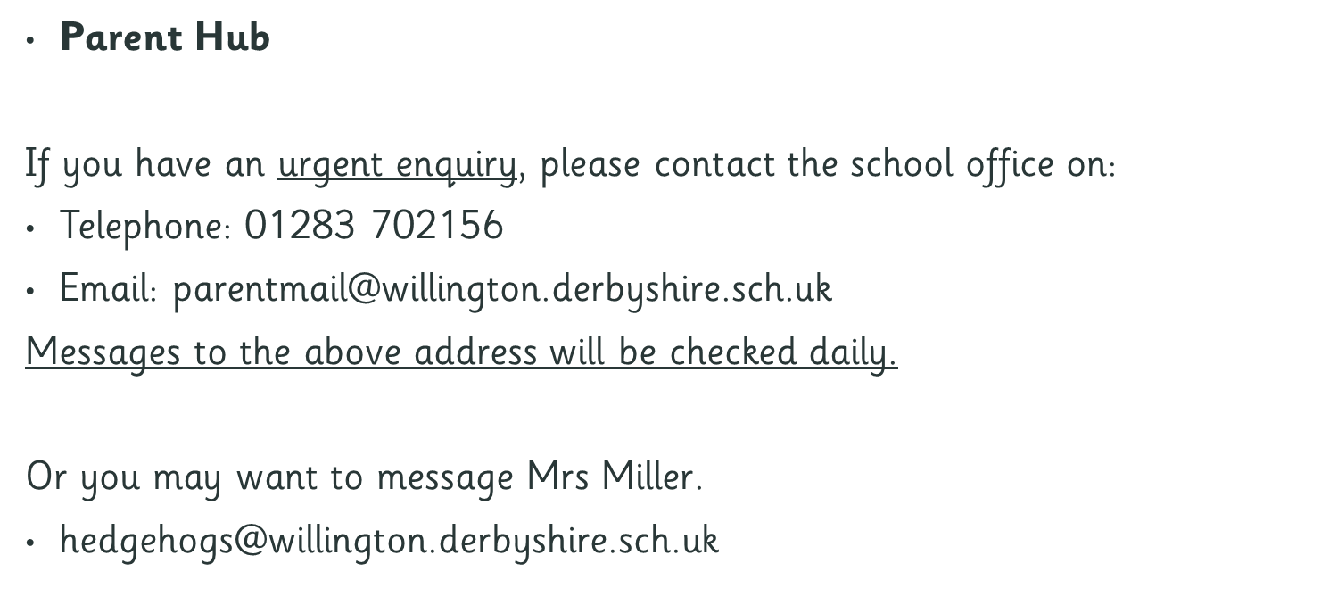
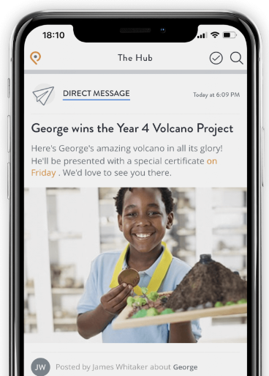
Communication

Slide 5
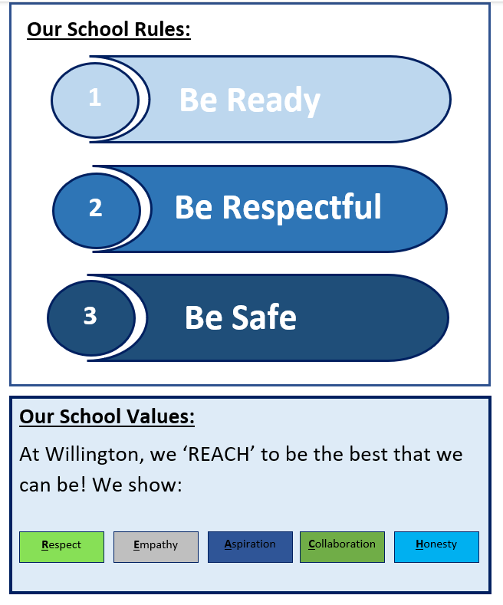

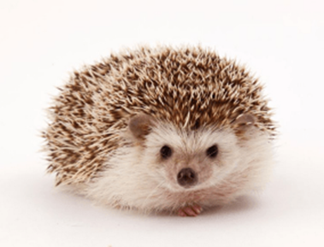
There is one Reception class in our school, and we are called
‘The Happy Hedgehogs’
In Key Stage One
(Reception, Year 1 and Year 2),
there are usually up to
30 children in each class.

Slide 6
We hold a
Celebration Assembly
every Friday. The children are rewarded for achievements and for following our school values.
Two children are selected from each class to either receive a
Star of the Week
or a
High Five Values Champion Award.
For Reception this takes place with the whole school after the first half term.

Slide 7

Arrangements for the
First few Days at school
Week 1 | Monday 7th September | Tuesday 8th September | From Wednesday 9th September
Morning | 9.30 to 12.30 Group A and stay for lunch | 9.30 to 12.30 Group B and stay for lunch | All children to attend full time from 8.45 – 3.30pm Entrance through the school gates on Vere Close
Afternoon | 1.15- 3.15 Group B | 1.15- 3.15 Group A
Please arrive at the front door with your child for the time stated in the table for the first two days. You will also need to collect your child from the front door as all other entrances will be locked.

Slide 8
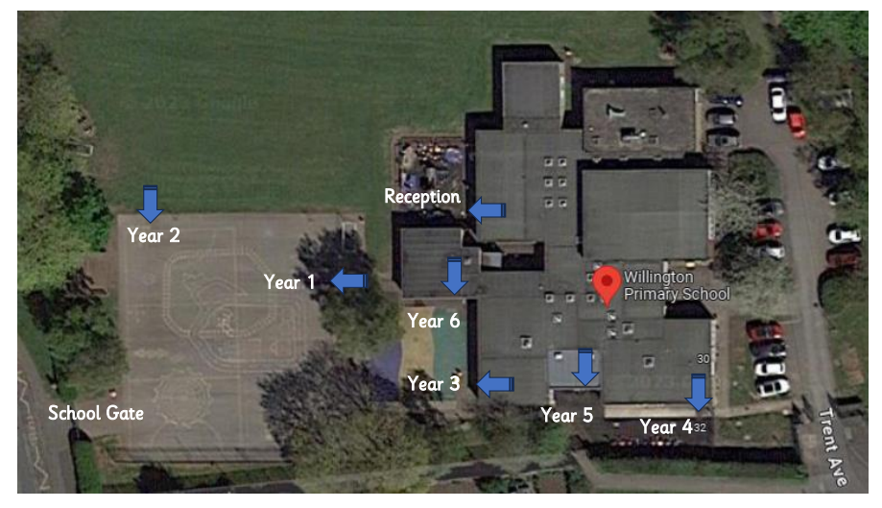
From Wednesday 9th September
All children (Group A and B) attend school full time from 8.45am to 3.30pm.
Please arrive and enter through the playground gates at the rear of the school from 8.45am.
There will be a number of staff on the gates to direct and support you and your child.
You will need to collect the children from the rear playground at the end of the day.
Reception children and parents gather here
Entrance at the rear of the school on
Vere Close
Front entrance from the end of Trent Avenue.

Slide 9
Daily Timetable
 | 8.45 to 9.10am | 9 .10- 9.30 | 9.30 to 10.15 | 10.15-10.30 | 10.30-10.45 | 10.45- 11.05 | 11.05-11.45 | 11.45 -12.00 | 12-1pm | 1.00-1.20 | 1.20- 3pm | 3pm- 3.30
Example Day | Doors open and we welcome children in for the register & to make dinner choices. | Daily Phonics and Reading | Classroom play based activities and adult led curriculum focused learning groups | Drink and Fruit Time | Playtime- Infants only | Song, Rhyme or Phonics Time | Classroom play based activities and adult led curriculum focused learning groups | Preparation for lunch. | Lunchtime | Register Daily Number and Counting Lesson | Classroom play based activities and adult led curriculum focused learning groups | Story and Discussion Time Preparation for Home.
From Monday 11th September
All children (Group A and B) attend school full time from
8.45am to 3.30pm
This is subject to change and an example of how a typical day runs.
Once whole school timetables have been organised in September you will be informed of PE days. On these days, we ask for the children to come to school in PE kits.
PE days can change half termly but we will keep you fully informed through our communication channels mentioned earlier and post details on the website.

Slide 10
Everyday your child will need to bring to school...
A waterproof coat appropriate for the time of year.
The children will be playing and learning outdoors, in all weathers, every day.
During winter, they will need gloves, hats and will need to wear a vest for warmth
under their uniform.
In summer, please make sure your child has suncream applied before school and they
have a sunhat with them.
2. A book bag.
3. Reading Record Book with reading and library books.
We will provide these during the second and third week in school.
These need to be kept in your child’s book bag to be brought in daily. We will change books over on a weekly basis, once they have been shared at home on a number of occasions.
Please note that you DO NOT need to provide a water bottle or drink. We will be providing this within school . Your child will have free access to water throughout the day and if they are under 5 years old, they will also be offered milk.
All children are also offered a fruit or vegetable snack during the morning.

Slide 11
Trays and Pegs
Your child will have a named peg to hang up their belongings and a tray.
It would help if you could help your child recognise their name so they can locate their peg and tray.
Please DO NOT send rucksacks or other bulky bags.
Objects from Home
Please encourage your child to leave personal belongings at home. We will try to ensure toys arriving at school from home, return home in good condition however it is quite possible for toys and belongings from home to get muddled with ours toys and may get damaged while at school.
School Uniform
Please make sure your child is dressed according to the school uniform as detailed in the School Prospectus. Headbands, clips and hair bobbles must be suitable, in plain blue/black, and jewellery (necklaces and bracelets etc) should be kept at home.
Long hair should be to be tied back and on days we have PE, ears that are pierced need to be covered with tape or removed.

Slide 12

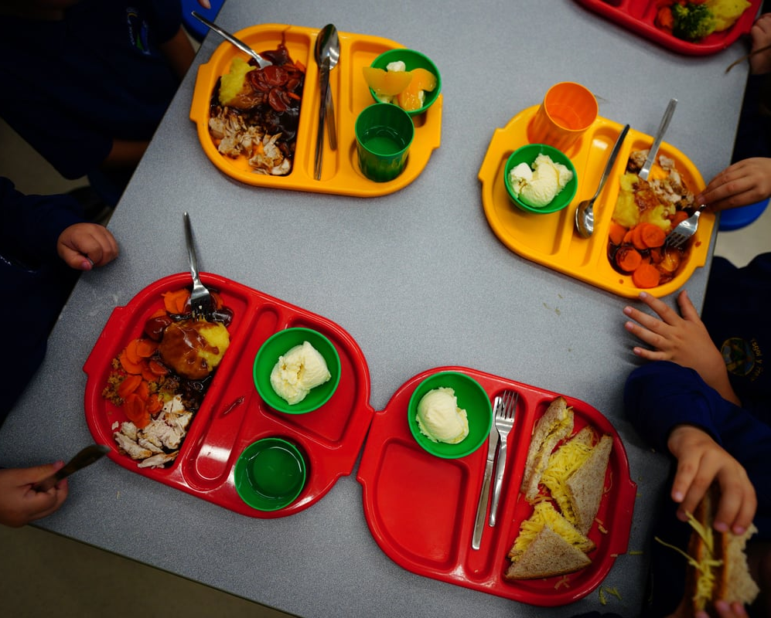
Personal Care and Skills
By time your child starts school, usually they should be able to dress and undress themselves and manage their own personal care.
Key Skills include: Eating using a knife, fork and spoons, drinking from an open cup, using the toilet and managing hand washing.
In school, they will need to be able to manage putting on and take off their coat, aprons and their shoes. When you are only 4 years old, velcro rather than shoe-laces, and elasticated waists on trousers or skirts are much easier to manage independently.
Practise over the summer, using zips and buttons on coats and cardigans. It is also wise to make sure your child can manage opening containers and packets in packed lunches.
Often children of this age have the occasional toilet accident. If this is the case for your child, it helps if you send them with a spare pair of pants/socks/trousers/skirt and a small plastic nappy bag for wet items.

Slide 13
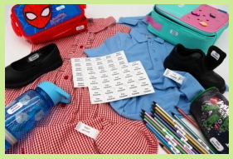


Label All Clothing and Belongings
Please ensure clothing such as jumpers, cardigans, coats and shoes, are clearly and permanently labelled with your child’s name and initial of their surname. It is very difficult to reunite items to their owners if they are not named.
At the beginning of the year, children often muddle their clothing with others, so we ask you to check weekly that you have your child’s belongings. Please return any items that do not belong to your child.
We would like to recommend ‘Stikins’ labels and kindly request a few of these labels to be sent into school (as soon as possible) so we can label both your child’s bottle and bottle lid. We have trialled these stickers on our water bottles over the last few months and some staff have used them in clothing with success.

Slide 14
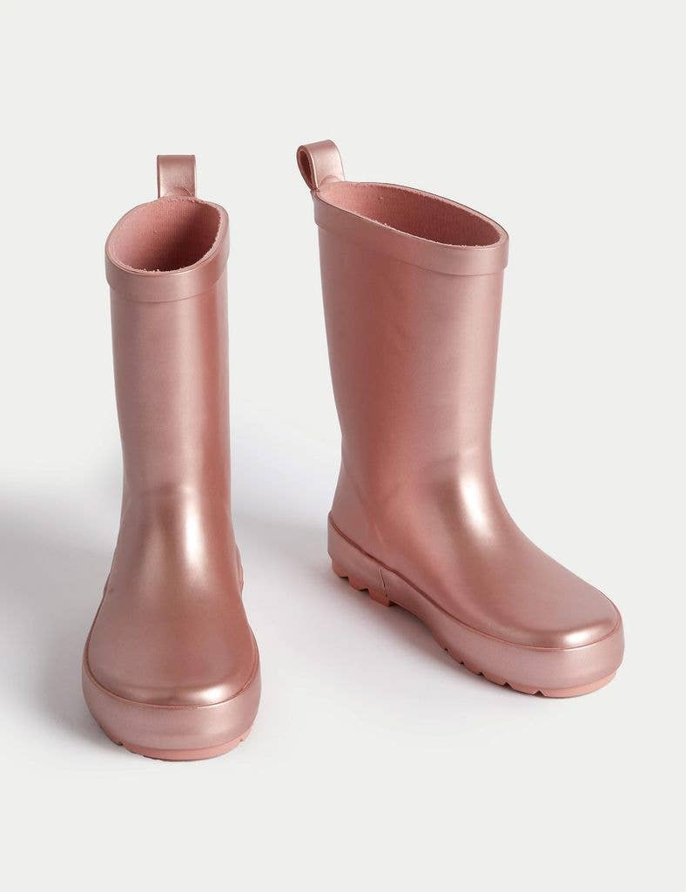
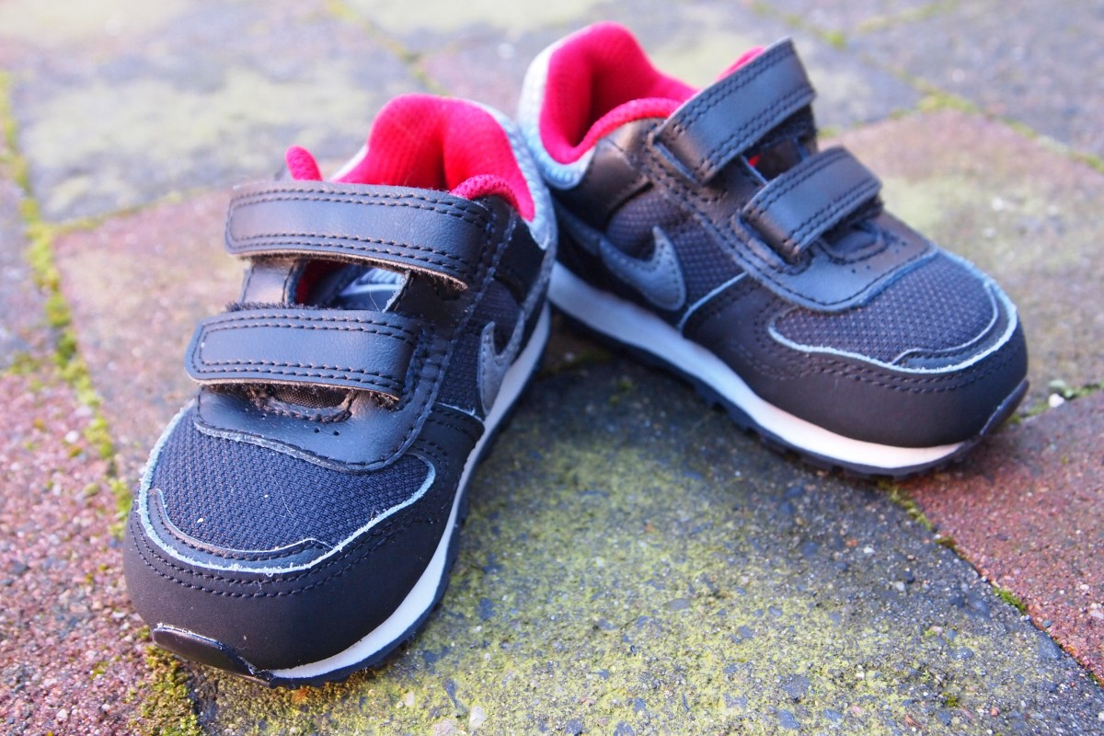
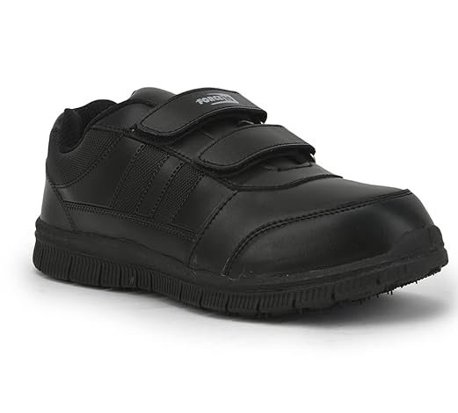
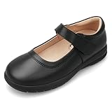
Shoes and Wellington Boots
Please ensure that your child wears well fitted suitable shoes to school. The children have access to outdoor physical activities throughout the day at school and shoes must be suitable for children to jog, jump, balance and climb in. Heels and strappy sandals, flipflops etc are not permitted. Trailing laces are also a hazard, so if you want your child to wear shoes with laces, they must be able to tie them up independently. Curriculum learning time is impacted, if a member of staff is required to spend time ensuring laces are tied up.
During the lunch break, our children have the opportunity to be involved with OPAL play. This involves play across the whole of our site- on the field, under the trees and in hedgerows. The children will be outside for this session in ALL WEATHERS so we ask you to provide a pair of wellies which we store outside on our welly stands. Children independently, take off their shoes and change into wellies when they need to, according to the weather. After lunchtime, they then locate their shoes in class storage boxes and take off their wellies, before coming into class. It helps the children if you have clearly labelled shoes and boots so that they can find their belongings.
It is important that your child can manage this with independence, as lunchtime staff will be supervising the outdoor area and dinner hall.
On the days we have PE, your child can wear trainers they can fasten.

Slide 15

Health
We will need to know about your child’s medical background to provide the right care while they are with us.
It is important to share with us if your child suffers from any allergies (e.g. bee stings, dairy, nut allergies etc), has asthma or eczema, or has any dietary requirements (e.g. specific dietary requirements due to health needs, vegetarian, Halal etc).
The EYFS Curriculum requires us to support and develop the children’s understanding of good lifestyle. This includes healthy eating, exercise, keeping clean and knowing how to take care of their teeth and learning about dentists, and appropriate sleep and screen time.
Screen time recommendations by the government have now been advised based on research.
Teaching staff have also noted changes children’s development over recent years and the impact on early learning.
Illness
Children can suddenly become ill and therefore it is important that we have information, so that we can contact you or another relative/ friend at all times.
PLEASE ENSURE THAT WE ARE KEPT UP TO DATE WITH YOUR CONTACT DETAILS.
What if my child is unable to attend school because they are ill?
Please phone (01283 702156) the school office on each morning of your child’s absence, before 9am.
Office staff will contact you regarding your child’s absence, if we are not kept informed.

Slide 16



Slide 17

Prime Areas
1. Communication and Language
2. Personal, Social and Emotional
Development
3. Physical Development
4. Literacy
5. Mathematics
6. Understanding of the World
7. Expressive Arts and Design

Slide 18
All Early Years settings and schools now follow an updated version of the EYFS Curriculum, which has been in place from September 2021.
The aim of the updated document is to improve the learning for all children and better prepare them for the move into year 1.
The changes also hope to give children the best start in life and set them up well for their future.
The updates have seen curriculum adjustments, additions and emphasis on the following areas…
D
Communication and Language Skills
Self-Regulation
Stories and Comprehension
Self-care,
Healthy Eating
and Oral Health
Physical Development Link between gross and fine motor skills
Vocabulary

Slide 19
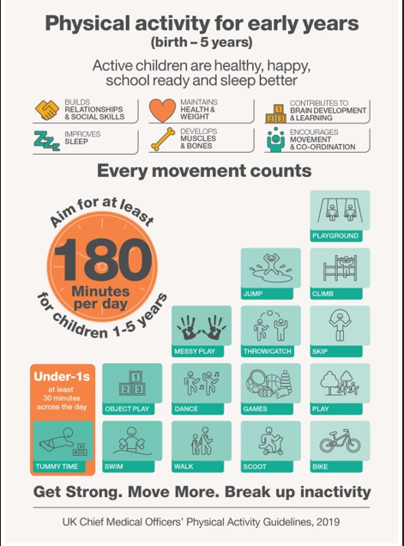

We use the Speech and Language Assessment and Support Programme ‘Wellcomm’ from the start of the year. This was developed by and is used by Speech and Language Therapists.
It helps us identify children who may need interventions for Speech and Language. Once identified, individual children are supported in school following the development programmes and supports staff in making referrals, if needed.

Slide 20
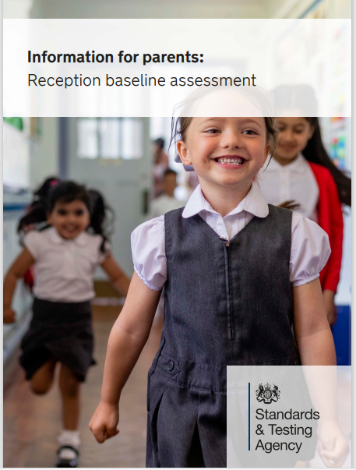
The Reception Baseline Assessment
The RBA became a statutory school assessment for pupils in Reception classes from September 2021.
It provides a starting point to measure progress schools make with their pupils between reception and the end of primary school.
It is interactive and practical, and teachers record results electronically to be submitted to the government.
It should take less than 20 minutes and it takes place during the first half term in school.
Assessments made are linked to the EYFS curriculum and include an assessment of Communication and Language, Literacy and Mathematics.
Pupils do not ‘Pass’ or ‘Fail’.

Slide 21
At the end of the reception year, children are assessed against the 17 Early Learning Goals (ELGs) and another government statutory assessment known as the EYFS Profile is completed.
You will be informed of the assessments that are made and it forms the basis of your annual parent report.
It is important to remember that….
The ELGs are not the EYFS Curriculum
The ELGs are not a test.
We use what we already know about a child to make decisions.
It is a summative report.

Slide 22

A love of reading is the biggest indicator of future academic success.
OECD (The Organisation for Economic Co-operation and Development)

Slide 23

Reading and Phonics
We use the Little Wandle Letters and Sounds Revised to teach children about the sounds (phonemes) of our spoken words and the letters (graphemes) that are used to write them down.
This is a government agreed systematic, synthetic phonic learning programme which the children start learning from the first full days in school.
Knowledge and skills are built up progressively throughout Reception and into Year 1. This prepares them for a statutory Phonics Screening Check, which takes place at the end of Year 1.
Phonics is taught every day.

Slide 24


Mathematics
Counting and maths fluency lessons take place every day.
Focus is on mathematical thinking and talking through well-structured and planned play activities.
Specific mathematics areas set up everyday indoors and outdoors for the children to access in their play.
Mathematical concepts are revisited often to ensure knowledge is embedded.
Lots of opportunity given to develop the understanding of number, shape, measure and spatial thinking.

Slide 25
Current Reception Topics
Autumn Term 1 | Autumn Term 2 | Spring Term 1 | Spring Term 2 | Summer Term 1 | Summer Term 2
It’s Good to be Me! | Awesome Autumn Celebrations | Our Wonderful World | Growing and Changing | Amazing Animals | The Great Outdoors
Each half term, an overview will be shared with you with details of the learning taking place relating to these topics.
It will also be available on our class page on the website.

Slide 26


