Slide 1





Reception
Happy Hedgehogs
Curriculum Information Meeting
for the Autumn Term
Thursday 10^{h} September 2026

Slide 2

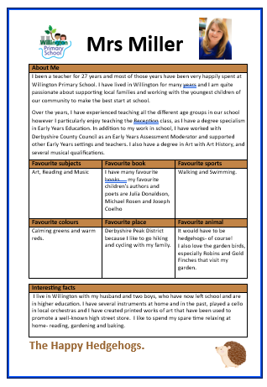
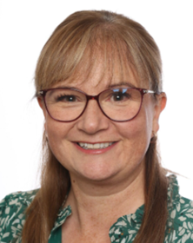
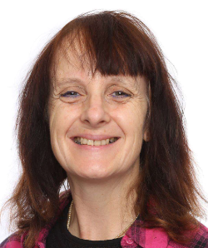
Mrs Miller
Class Teacher
Teaching Assistants
Mrs Power

Slide 3



Communication
Parenthub is used to send school messages out to you.
For example, there may be a change to our P.E. timetable or reminder about an event in school.
We also attach school information letters to these messages.
If you have an urgent enquiry, please contact the school office on:
Telephone: 01283 702156
Email: parentmail@willington.derbyshire.sch.uk
Messages to the above address are checked daily.
Or you may want to message Mrs Miller -
hedgehogs@willington.derbyshire.sch.uk

Slide 4
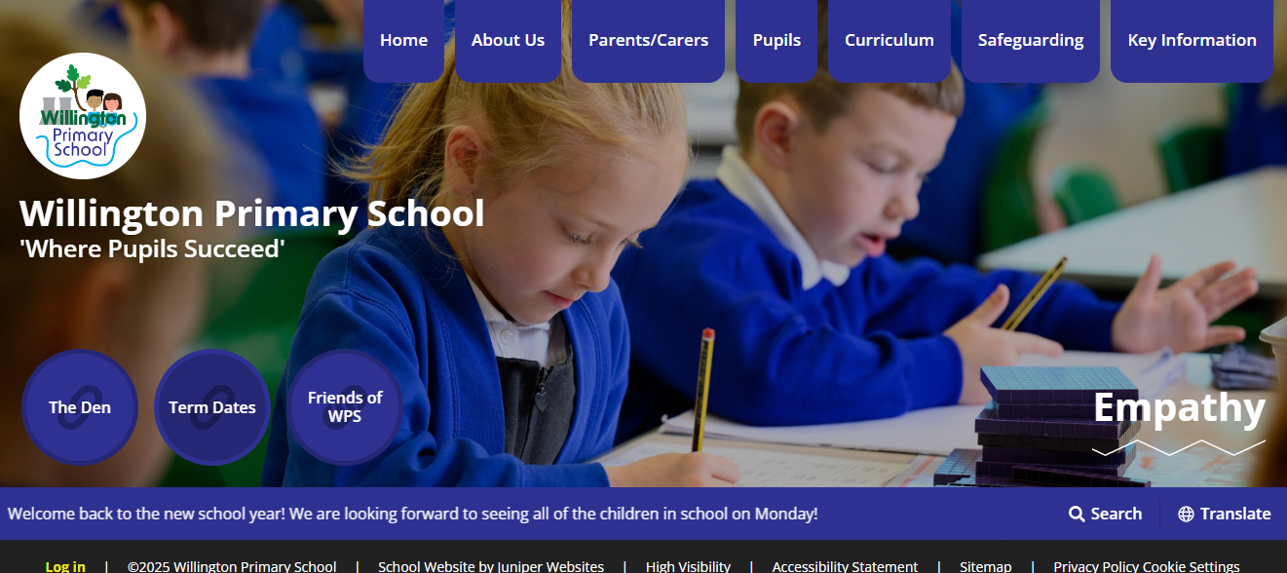

Information is also available on our school website
www.willington.derbyshire.sch.uk
Look under the Pupils and 2026-2027 New Reception

Slide 5
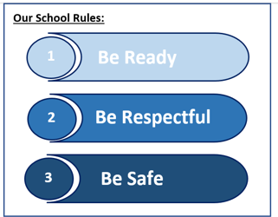


Behaviour and Rewards
Happy Hedgehogs Classroom Rules.
1. Kind Hands and Feet. 2. Kind Words.
3. Good Sitting. 4. Good Listening.
5. Walk Indoors 6. Use Indoor Voices
7. Share and Take Turns 8. Good Tidying
We use an in the moment system of rewards and reminders to support
children in regulating their behaviour and ensuring they understand our
expectations. We may give out stickers, stamps on written or recorded work, or send home
notes/certificates to reward children.
Throughout the school, children can be awarded Carrot Tokens or House Points
Children can collect tokens for a class reward. As we join in with whole school assemblies
towards the end of this half term, we move onto the Carrot Token system that runs
throughout school and we will compete against the other classes each week.
School House Points .
Our four School House Teams are- Red Eagles, Blue Hawks, Green Falcons and Yellow Owls. You will find in the front of your child’s Home School Diary, your child’s allocated House Team.
Curtesy and Respect

Slide 6

Early Years Foundation Stage
Core Prime Areas
Communication and Language
Personal, Social and Emotional Development
Physical Development
(Gross and Fine Motor Skills)
Specific Areas
Literacy
Mathematics
Understanding the World
Expressive Arts and Design
Statutory Requirements 2025: All meals, snacks and drinks must be healthy, balanced and nutritious.
(New EYFS Nutrition Documentation and Guidance)
We have introduced school provided water bottles for all children that are available continuously throughout the day. These are named (bottle and top), sterilised and washed at the end of each day. They are refilled daily and when needed.
For children under 5 years, milk is also provided during the morning. Only water is offered during lunchtime.
We also have a ‘Snack Time’ before morning playtime. Children are usually offered a choice of two fruit/vegetable options and they must sit to eat and be supervised by a Paediatric First Aider. Please do not send additional snacks into school.

Slide 7

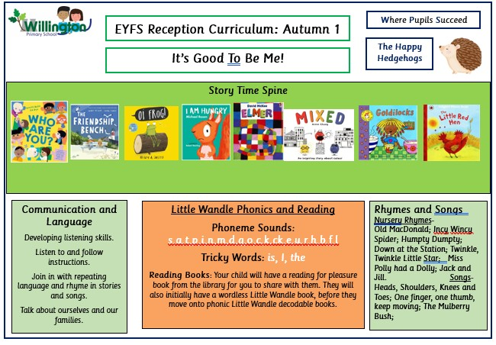
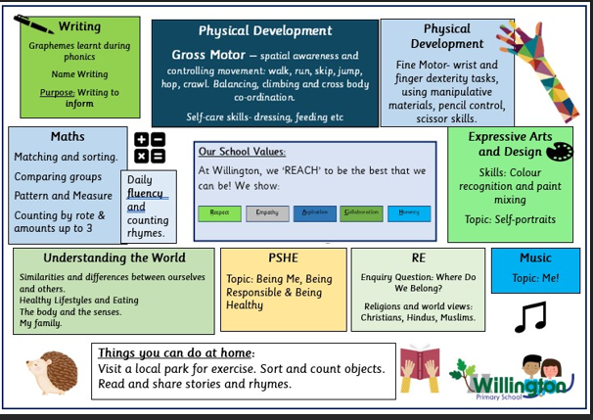
Communication and language is the key to foundational learning.
As EYFS staff we prioritise play with lots of speech and language enrichment.
Autumn Term 1 | Autumn Term 2 | Spring Term 1 | Spring Term 2 | Summer Term 1 | Summer Term 2
It’s Good to be Me! | Awesome Autumn Celebrations | Our Wonderful World | Growing and Changing | Amazing Animals | The Great Outdoors
Each half term, an overview will be shared with you on our class website.

Slide 8

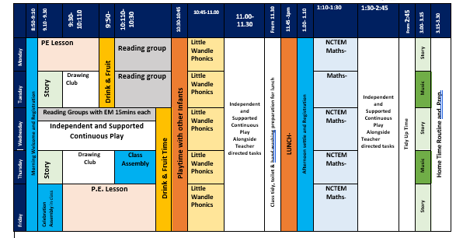
Daily Routines and Timetable
Please be aware that as we progress through the year this timetable may change and be adjusted.

Slide 9

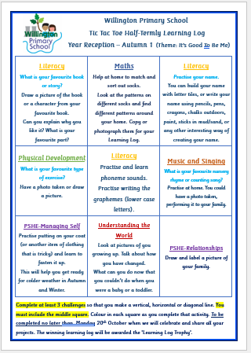
Learning Logs
Your child will be given a homework book with suggested learning activities for you to complete at home over the half term. The centre activity is the top priority. Then you choose another two to complete ‘three in a row’.
If you wish, you can complete additional tasks.
The activities suggested, link to our topics and are in line with the curriculum design for each half term.
We have a Learning Log Champion each half term and displays of completed homework.

Slide 10

Reading and Phonics
We use the Little Wandle Letters and Sounds Revised to teach children about the sounds (phonemes) of our spoken words and the letters (graphemes) that are used to write them down.
This is a government agreed systematic, synthetic phonic learning programme which the children start learning from the first full days in school.
Knowledge and skills are built up progressively throughout Reception and into Year 1. This prepares them for a statutory Phonics Screening Check, which takes place at the end of Year 1.
Phonics is taught every day.

Slide 11
Phonics is:
making connections between the sounds of our spoken words and the letters that are used to write them down.
Notes:
It sounds complicated but it really isn’t!

Slide 12
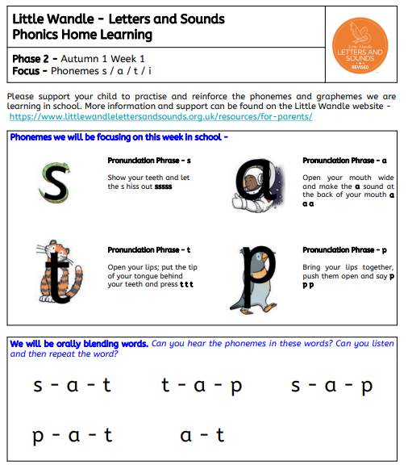


Phonics Teaching Order and Progression
Keeping You Informed….
Phonic Information Sheets and details maybe added to your child’s Home School Diary.
We also have information available on the school website including all weblinks for Little Wandle Support for Parents.
Notes:
We usually teach four new sounds a week and have a review lesson on a Friday. You will get a list of the sounds that we are learning to have at home. This will help you with formation and pronunciation.

Slide 13
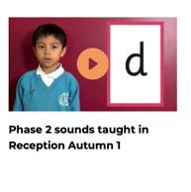

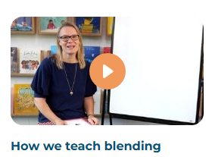
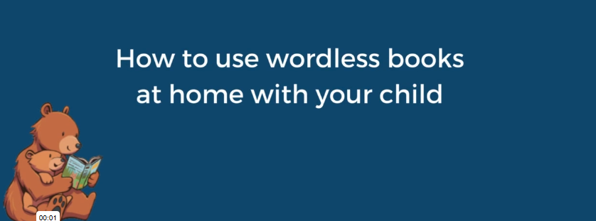
www.littlewandle.org.uk/resources/for-parents
Notes:
It is really important that you pronounce the sounds correctly at home if you are supporting your child. These videos are on the website for you to refer to and if you are unsure, please ask your child’s teacher.
Show the parents where to access the videos on the website and play them!

Slide 14
How do we teach reading in books?
Reading practice sessions are:
timetabled several times a week
taught by a teacher in small groups.
If your child is needing additional support, they may also read individually to a trained Teaching Assistant.
Notes:
The more they see words the more they begin to read them automatically without having to sound them out.

Slide 15

This means that your child should:
Know the sounds and tricky words in their phonics book
They should be able to ‘sound out’ and blend words. They should be able to do this with a little support at home.
At home, they are should re-read these books at least five times over the week to ensure familiarity with the letters and words. This will help your child’s long-term memory and support them in developing reading fluency.

Slide 16

Books going home
Notes:
As well as the ‘learning to read’ book that your child will bring home they will also bring home a book for sharing with you. This book is SO important. This is how we are going to give them the WILL to read. Please read with your child as often as you can – at least once a day if possible.

Slide 17

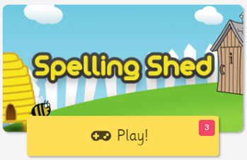
Phonics and Spelling
Say the word.
Segment the sounds.
Count the sounds.
Write them down.
https://www.edshed.com/en-gb/login
Please see Information sheets.
Login with the details in your child’s Home School Diary.
Games/assignments have been created to match phonics lessons being taught in our Little Wandle Phonics lessons.
Notes:
Model the process on a flipchart for the parents to see.

Slide 18

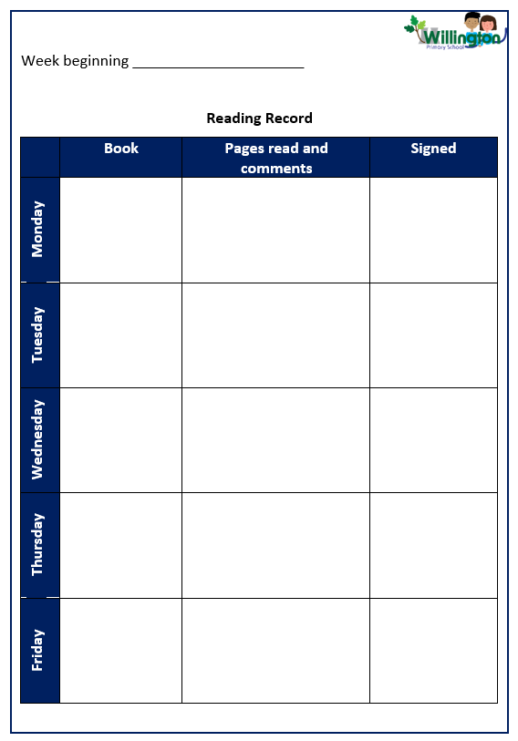
Homework
Support your child in learning to say the phonemes correctly.
When hearing them read, encourage them to point to the words and use their phonic knowledge to blend phonemes and read the words.
We expect children to share and read books with their parents or an adult at
least 5 times a week.
Keep these times short (10 minutes) and enjoyable.
Little and often is the key to success!
Please initial the ‘Signed’ box and make a comment, if you wish.

Slide 19


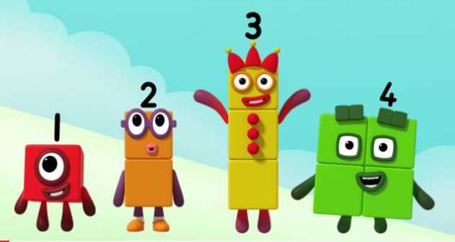
Mathematics
Focus is on mathematical thinking and talking through structured and planned play activities.
Mathematical concepts are revisited often.
Lots of opportunity given to develop mathematical language and the understanding of number, shape, measure and spatial thinking.
We use NCTEM methods and resources to support our teaching.
Cbeebies Numberblocks is used and referred to throughout the year.

Slide 20


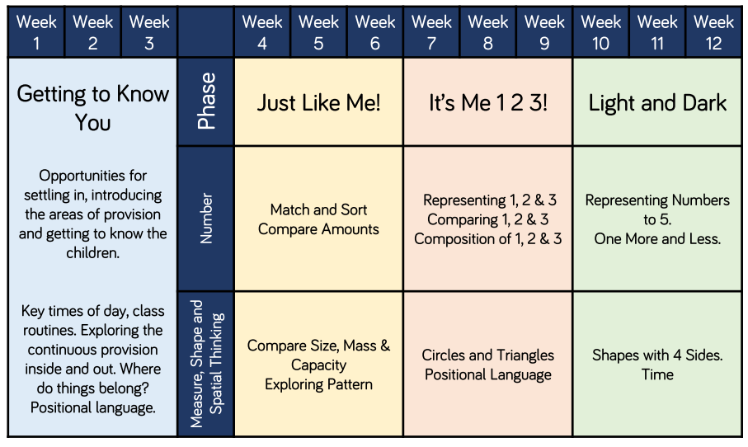
Autumn Term Planning Overview

Slide 21
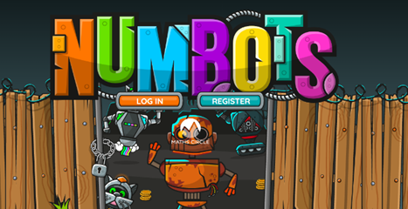
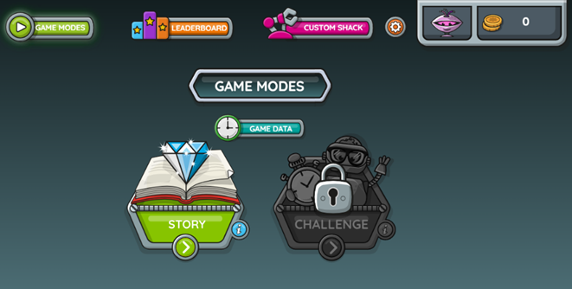
Numbots Game
https://play.numbots.com/#/account/school-login-type
Please read the Numbots Information Sheet. You can find login details in your child’s Home School Diary.

Slide 22
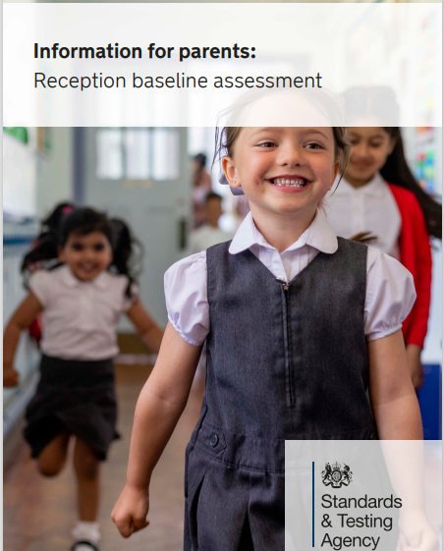
The Reception Baseline Assessment
The RBA became a statutory school assessment for pupils in Reception classes from September 2021.
It provides a starting point to measure progress schools make with their pupils between reception and the end of primary school.
It is interactive and practical, and teachers record results electronically to be submitted to the government.
It takes approximately 20 minutes, but time can be broken up according to children’s need.
It takes place during the first six weeks in school.
Assessments include an assessment of Communication, Language and Literacy and Mathematics.
Pupils do not ‘Pass’ or ‘Fail’.
A copy of the government ‘Information for Parents’ leaflet in on our website to read.

